Slide 1
TRAVELING SALESMAN PROBLEM USING ANT COLONY OPTIMIZATION
MADE BY: HELI SHAH(733914949)
SUKET SINGH(923377656)
UNDER THE GUIDANCE OF:
DR. CHILUKURI MOHAN

Slide 2
WHAT IS ANT COLONY OPTIMIZATION?
It is a population based metaheuristic which can be used to find approximate solutions to difficult optimization problems.
In ACO, “artificial ants” search for best path on a weighted graph.
The solution construction is biased by a Pheromone model which is associated with a set of parameters whose values are modified at the runtime by the ants.

Slide 3

APPLYING ACO
Defining a Combinatorial Optimization Problem (COP) in the form of triplets:
S: finite search space among discrete decision variables
Ω: set of constraints among variables
f: an objective function to be minimized
The solution is optimum if only: for every s in S.
$$f(s∗)≤f(s)$$

Slide 4
ACO METAHEURISTIC
Set parameters, initialize pheromone trails
SCHEDULE_ACTIVITIES
Construct AntSolutions
DaemonActions //optional
Update Pheromones
END_SCHEDULE_ACTIVITIES

Slide 5
MAIN ACO ALGORITHMS
ANT SYSTEM: The pheromone values are updated by all the ants that have completed the tour. While constructing the graph solution, the ants make probabilistic decision at each of the vertex.
ANT COLONY SYSTEM: For constructing the solution, ACS follows the greedy rule to locally update the pheromone, which is performed by all the ants after each construction iteration. In ACS, at the end of the construction process, the pheromone updating is done by only the best ant.
MIN-MAX ANT SYSTEM: In MMAS, only the best ants add to the pheromone trail. Also, the minimum and maximum values of the pheromone are explicitly limited.

Slide 6
ACO FOR TSP
The traditional TSP can be preferred to be solved by ACO due to two of its reasons:
It is a Combinatorial Optimization Problem (it finds a solution that satisfies the conditions and minimizes or maximizes the objective function)
It is NP-Complete
So, here we have to find the Hamilton circle in the graph of cities having least weight associated with the edges.

Slide 7
ALGORITHM
For a TSP solution using ACO, the ants will have the following characteristics :
The probability of selecting a city is the function of distance between the cities and the current pheromone margin on that branch.
The ants are allowed to swim the visited city until a tour is completed.
Ant leaves a pheromone on each visited branch while completing a tour.

Slide 8
INTRODUCING THE ANTS
class Ant(object):
def __init__(self,ID):
self.ID = ID ### taking the total number of ants to be 50, each distinguished by ID
self.__clean_data()
def __clean_data(self):
self.path = []
self.total_distance = 0.0
self.move_count = 0
self.current_city = -1
self.open_table_city = [True for i in xrange(city_num)]
city_index = random.randint(0,city_num-1)
self.current_city = city_index
self.path.append(city_index)
self.open_table_city[city_index] = False
self.move_count = 1

Slide 9
PROGRESSING IN SEARCH SPACE
select_citys_prob[i] = pow(pheromone_graph[self.current_city][i], ALPHA) * pow((1.0/distance_graph[self.current_city][i]), BETA)
total_prob += select_citys_prob[i]
As the search processes, the ant calculates the state transition probability based on the amount of information on each path and the heuristic information on the path, which is proportional to the pheromone and inversely proportional to the distance.
As time goes by the continuous computations, the amount of information previously left on each path gradually disappears.
After the ants complete a cycle, the amount of information on a path is adjusted according to the above formula.

Slide 10
UPDATING PHEROMONE
def __update_pheromone_gragh(self):
temp_pheromone = [[0.0 for col in xrange(city_num)] for raw in xrange(city_num)]
for ant in self.ants:
for i in xrange(1,city_num):
start, end = ant.path[i-1], ant.path[i]
temp_pheromone[start][end] += Q / ant.total_distance
temp_pheromone[end][start] = temp_pheromone[start][end]
for i in xrange(city_num):
for j in xrange(city_num):
pheromone_graph[i][j] = pheromone_graph[i][j] * RHO + temp_pheromone[i][j]
Here the iterations are started, which search for the path based on the current city and the concentration of the pheromone between the two cities. It is then compared to the current solution in all paths and accordingly updates the optimal solution.

Slide 11
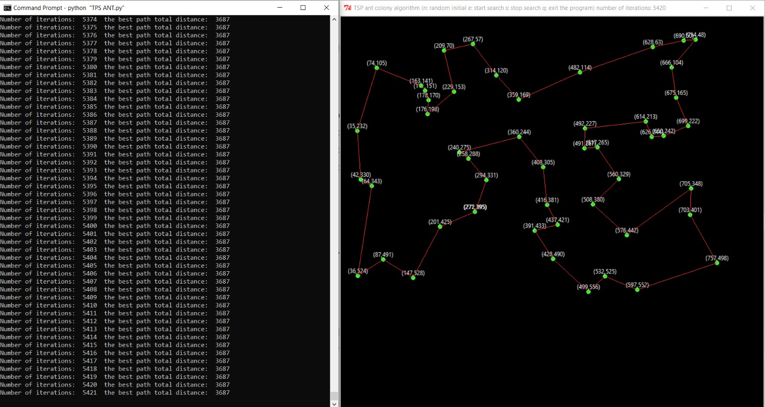
ACO OUTCOME

Slide 12
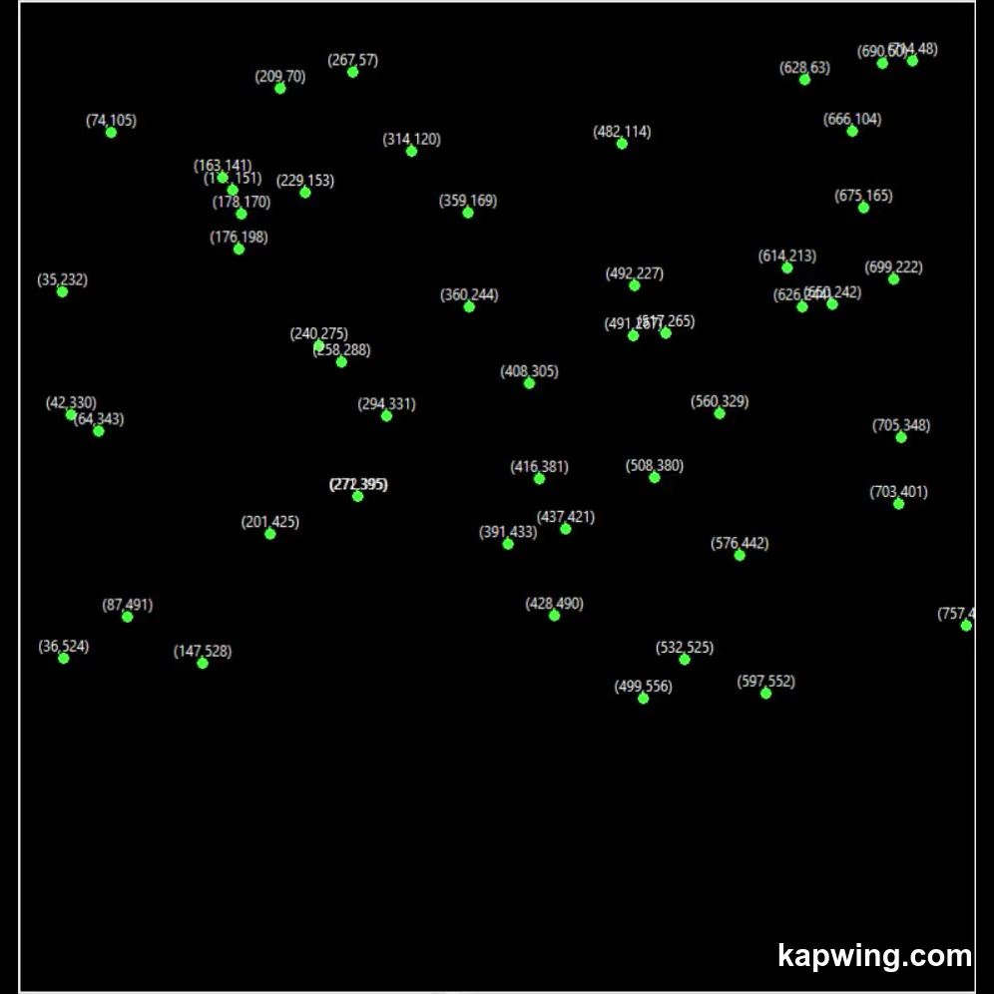
ACO OUTCOME

Slide 13
GA FOR TSP
Following the GA principles for TSP:
Randomly initialize certain individual
Population breeding longevity offspring under given crossover probability
New individual mutates certain probability, which may produce better fitness.
These fitness is ofcourse inversely proportional to the path length.
After a certain number of iterations, the individual gene sequence with the highest fitness corresponds to a better traversal path.

Slide 14
GA FOR TSP
self.ga = GA(
lifeCount = 50, ### Population Size
xRate = 0.7, ### Crossover Rate
mutationRate = 0.1, ### Mutation Rate
judge = self.judge(),
mkLife = self.mkLife(),
xFunc = self.xFunc(),
mFunc = self.mFunc(),
save = self.save()
)

Slide 15
CROSSOVER FOR GA
def xFunc(self):
def f(lf1, lf2):
p2 = random.randint(1, self.n - 1)
g1 = lf2.gene[0:p2] + lf1.gene
g11 = []
for i in g1:
if i not in g11:
g11.append(i)
return g11
return f

Slide 16
MUTATION FOR GA
def mFunc(self):
def f(gene):
p1 = random.randint(0, self.n - 1)
p2 = random.randint(0, self.n - 1)
while p2 == p1:
p2 = random.randint(0, self.n - 1)
gene[p1], gene[p2] = gene[p2], gene[p1]
gene.append(gene[p2])
del gene[p2]
return gene
return f

Slide 17
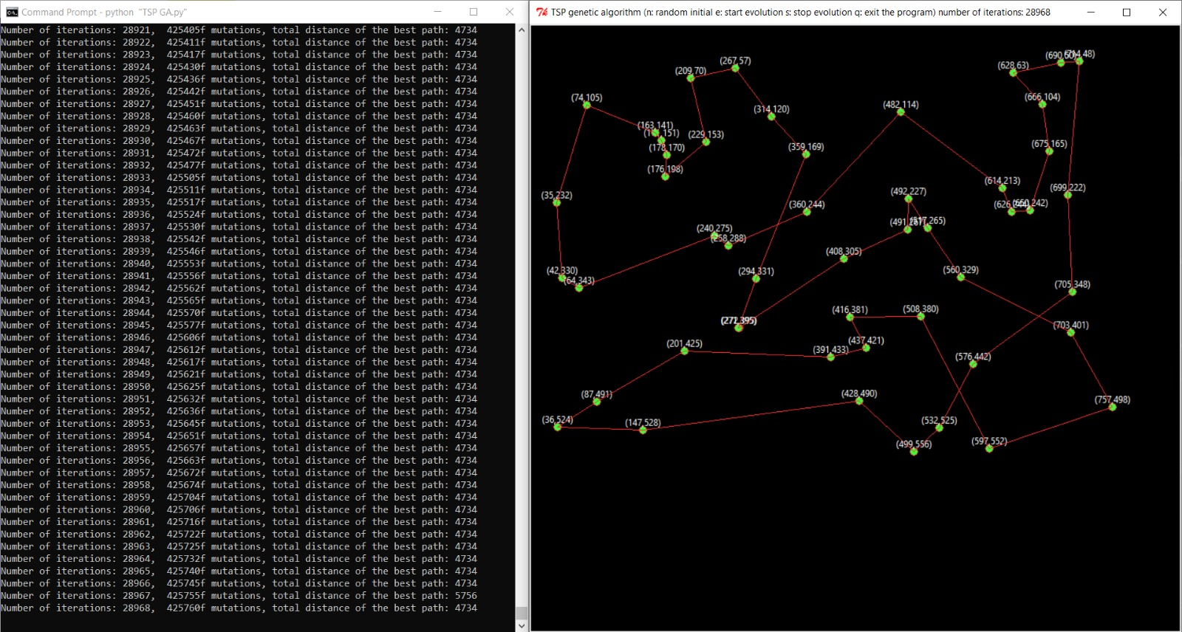
OUTPUT OF GA
After the crossover and mutation, individuals with higher fitness are selected to generate new individuals in each iteration, which enables us to select the optimal solution for the individual genetic update with the highest fitness in the new population.

Slide 18
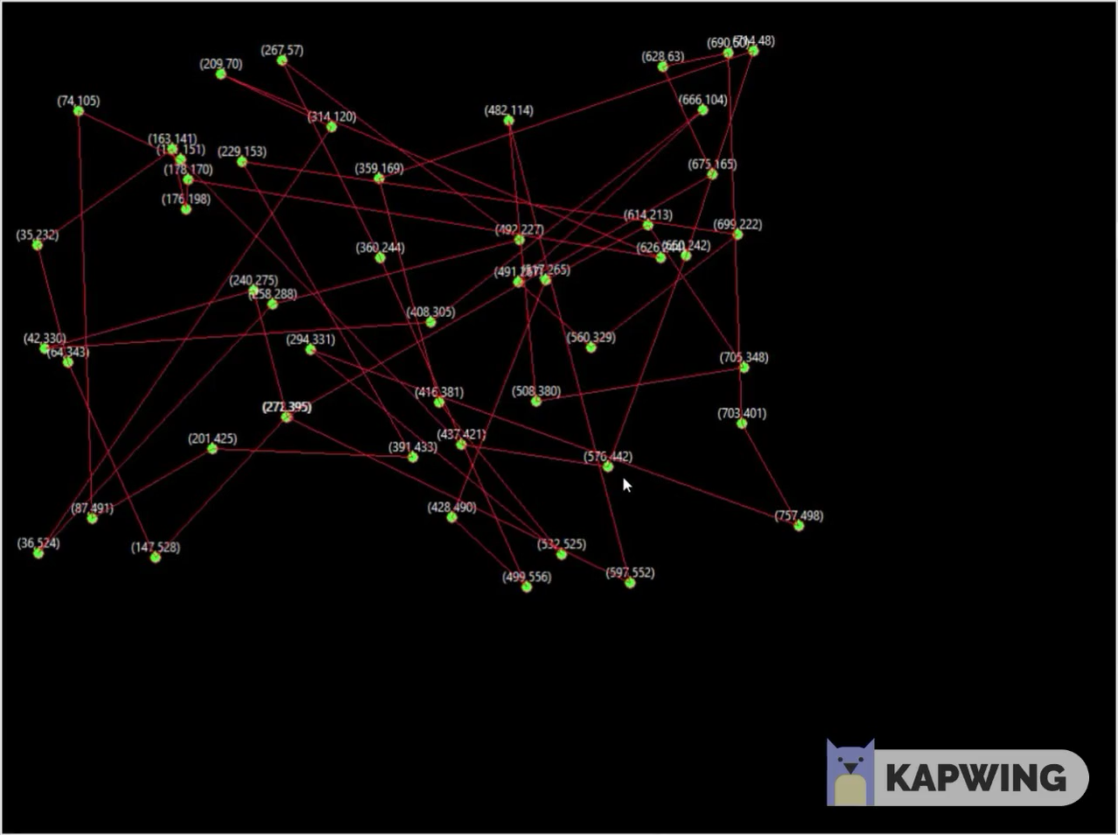
OUTPUT OF GA

Slide 19
COMPARISON OF ACO AND GA
From the outputs of both the algorithms for traditional TSP, we observed that the best path in Ant Colony Optimization is achieved just only 823 iterations, while Genetic Algorithm achieves its best path after 50,000 iterations which is still far lower in efficiency when compared to ACO.
Also, the ACO gives the best path to be of 3687 while GA gives that of 4734.
Hence, ACO provides OPTIMAL as well as BEST solution for the addressed TSP.

Slide 20
CONCLUSION
Based on the results obtained, we have come to a conclusion that:
1. ACO should be used for large and complex problems (greater computation resources).
2. GA should be used for low computational resources (small sized problems).
For our database, ACO proved to be far more efficient than GA.

Slide 21
REFERENCES
https://pdfs.semanticscholar.org/b547/a2a20b88d1f01a10d0a8e67edd1132540e5d.pdf
http://www.scholarpedia.org/article/Ant_colony_optimization
http://ijarcsse.com/Before_August_2017/docs/papers/Volume_6/3_March2016/V6I3-0115.pdf

Slide 22
THANK YOU

